Slide 1
Analytical Methods for Business
Dr. Ronald K. Satterfield
Muma College of Business
University of South Florida

Slide 2
Module 3 Sample v. Population Means
Dr. Ronald K. Satterfield
Muma College of Business
University of South Florida
Leveraging Samples to Understand Populations

Slide 3
Comparing Two Populations One of These Things is Not Like the Other
Dr. Ronald K. Satterfield
Muma College of Business
University of South Florida

Slide 4
Plan for This Presentation
Basic Idea
Two Kinds of Tests
Confidence Intervals
Hypothesis Tests
Interpreting Results
Introduction | Two Poplns. Indep. | Two Poplns. Paired | Grocery | Conclusions | Assignment

Slide 5
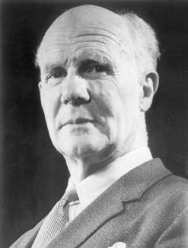
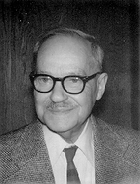
Hypothesis Testing
Egon Pearson
Jerzy Neyman
Introduction | Types of Data | Types of Sampling | Descriptive Statistics | Graphical Tools | Conclusion

Slide 6
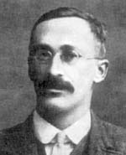
The t Distribution
William Gosset
Introduction | Types of Data | Types of Sampling | Descriptive Statistics | Graphical Tools | Conclusion

Slide 7
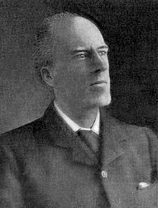
The Roots of the Hypothesis Testing Idea
Experiments are all sloppy. All give variable results when repeated. We’re interested in the distribution of experimental results. From that we can derive a probability that an observed value will be a given value.
Karl Pearson
Introduction | Types of Data | Types of Sampling | Descriptive Statistics | Graphical Tools | Conclusion

Slide 8
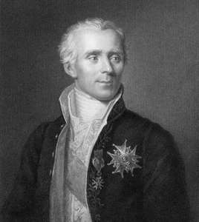
Laplace, 1749 - 1827
1820: Described a statistical distribution he called the error distribution. Applied it to statistics in astronomy. A precursor to the normal distribution.
Pierre-Simon
Marquis de Laplace
Introduction | Types of Data | Types of Sampling | Descriptive Statistics | Graphical Tools | Conclusion

Slide 9
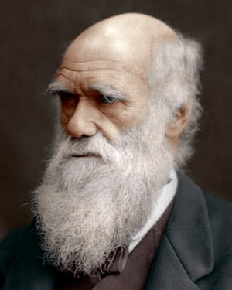
Darwin, 1809 - 1882
Biological variation is necessary for evolution to take place.
Charles Darwin
Introduction | Types of Data | Types of Sampling | Descriptive Statistics | Graphical Tools | Conclusion

Slide 10
Plan for This Presentation
Basic Idea
Two Kinds of Tests
Confidence Intervals
Hypothesis Tests
Interpreting Results
Introduction | Two Poplns. Indep. | Two Poplns. Paired | Grocery | Conclusions | Assignment

Slide 11
Basic Scenario
What Have We Done So Far
How Is That Changing Now
Introduction | Two Poplns. Indep. | Two Poplns. Paired | Grocery | Conclusions | Assignment

Slide 12
Types of Tests
Independent Sampling
Paired Differences (Paired Comparisons)
Repeated Measures (or Independent Sampling)
Matched Samples (or Paired Comparisons)
Introduction | Two Poplns. Indep. | Two Poplns. Paired | Grocery | Conclusions | Assignment

Slide 13



Independent Sampling
Intelligence Testing
Introduction | Two Poplns. Indep. | Two Poplns. Paired | Grocery | Conclusions | Assignment

Slide 14
Independent Sampling Confidence Interval
Introduction | Two Poplns. Indep. | Two Poplns. Paired | Grocery | Conclusions | Assignment

Slide 15
Independent Sampling Hypothesis Test
Introduction | Two Poplns. Indep. | Two Poplns. Paired | Grocery | Conclusions | Assignment

Slide 16
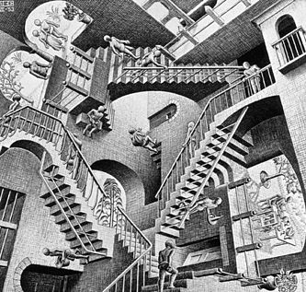
Counter-Intuitive Results
Relativity by M.C. Escher, 1953
Introduction | Two Poplns. Indep. | Two Poplns. Paired | Grocery | Conclusions | Assignment

Slide 17


Counter-Intuitive Results
Introduction | Two Poplns. Indep. | Two Poplns. Paired | Grocery | Conclusions | Assignment

Slide 18
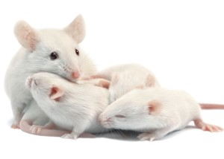
Paired Differences
Introduction | Two Poplns. Indep. | Two Poplns. Paired | Grocery | Conclusions | Assignment

Slide 19
Paired Differences Confidence Interval
Introduction | Two Poplns. Indep. | Two Poplns. Paired | Grocery | Conclusions | Assignment

Slide 20
Paired Differences Hypothesis Test
Introduction | Two Poplns. Indep. | Two Poplns. Paired | Grocery | Conclusions | Assignment

Slide 21
Grocery Data
Select Two Regions
Take a Random Selection from Each of the Two
Can we say mean customer penetration in Fairview stores is greater than .2?
Can we say mean customer penetration in Fairview stores is greater than .22?
Compare Deli Square Feet for the Two Regions
Compare Deli Sales for the Two Regions. Is the difference in the population means greater than 35000 in favor of Summerfield?
Run hypothesis test over a range capturing p values and graphing
Introduction | Two Poplns. Indep. | Two Poplns. Paired | Grocery | Conclusions | Assignment

Slide 22
What Have We Covered in this Section?
Concept of Comparing Two Populations
Independent Sampling
Paired Differences (Paired Comparisons)
Confidence Intervals
Hypothesis Tests
Interpretation
Introduction | Two Poplns. Indep. | Two Poplns. Paired | Grocery | Conclusions | Assignment

Slide 23
Assignment
Introduction | Two Poplns. Indep. | Two Poplns. Paired | Grocery | Conclusions | Assignment

